Slide 1
Hierarchical Clustering
Asst. Prof. Priyalba Vaghela
Devang Patel Institute of advance Technology & research
Faculty of Technology
Charotar University of science & Technology

Slide 2
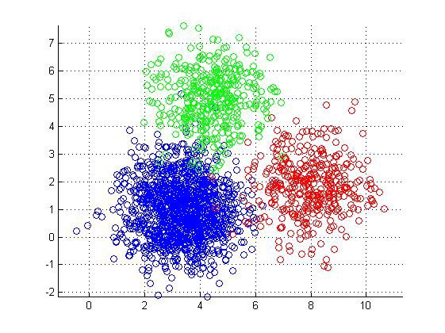
Cluster
Clustering is a technique that groups similar objects such that the objects in the same group are more similar to each other than the objects in the other groups. The group of similar objects is called a Cluster.
Types of Clustering
K-Means Clustering
Hierarchical Clustering
Mean-Shift Clustering
Density-Based Spatial Clustering of Applications with Noise (DBSCAN)
Expectation-Maximization (EM) Clustering using Gaussian Mixture Models (GMM)

Slide 3
Hierarchical Clustering
It is an unsupervised clustering algorithm which involves creating clusters that have predominant ordering from top to bottom.
For e.g: All files and folders on our hard disk are organized in a hierarchy.
The algorithm groups similar objects into groups called clusters. The endpoint is a set of clusters or groups, where each cluster is distinct from each other cluster, and the objects within each cluster are broadly similar to each other.
This clustering technique is divided into two types:
Agglomerative Hierarchical Clustering
Divisive Hierarchical Clustering

Slide 4
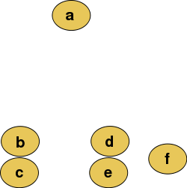
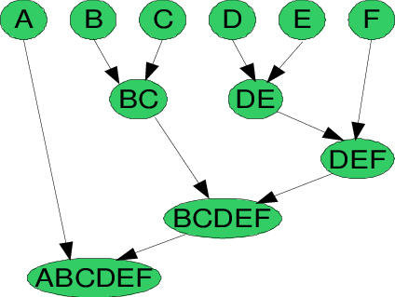
Agglomerative Hierarchical Clustering
In this technique, initially each data point is considered as an individual cluster. At each iteration, the similar clusters merge with other clusters until one cluster or K clusters are formed.
The basic algorithm of Agglomerative is straight forward.
Compute the proximity matrix
Let each data point be a cluster
Repeat: Merge the two closest clusters and update the proximity matrix
Until only a single cluster remains
Raw data
Key operation is the computation of the proximity of two clusters
Traditional representation

Slide 5
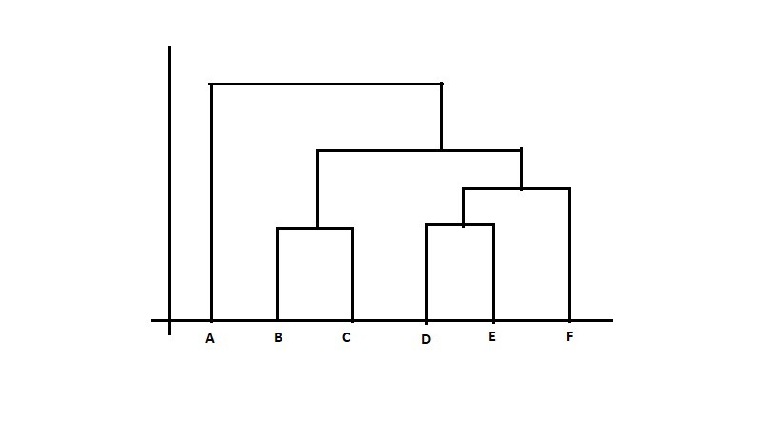
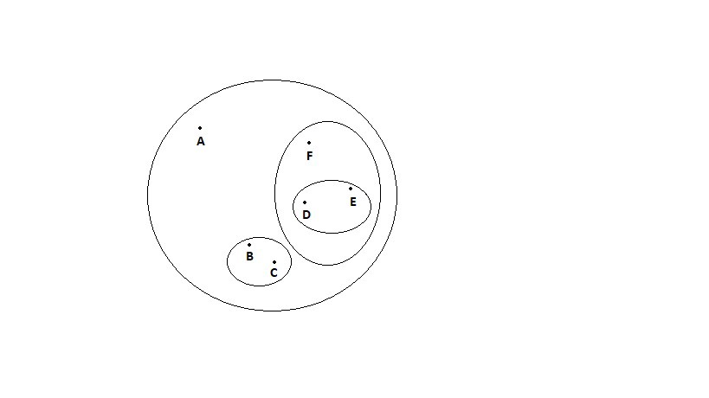
Agglomerative Hierarchical Clustering
The Hierarchical clustering Technique can be visualized using a Dendrogram.
A Dendrogram is a tree-like diagram that records the sequences of merges or splits.

Slide 6
Divisive Hierarchical clustering Technique
The Divisive Hierarchical clustering is exactly the opposite of the Agglomerative Hierarchical clustering. In Divisive Hierarchical clustering, we consider all the data points as a single cluster and in each iteration, we separate the data points from the cluster which are not similar. Each data point which is separated is considered as an individual cluster. In the end, we’ll be left with n clusters.
As we’re dividing the single clusters into n clusters, it is named as Divisive Hierarchical clustering.
The Divisive Hierarchical clustering Technique is not much used in the real world

Slide 7
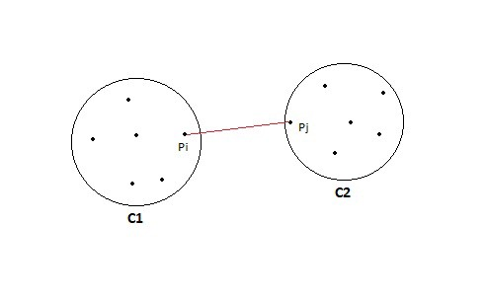
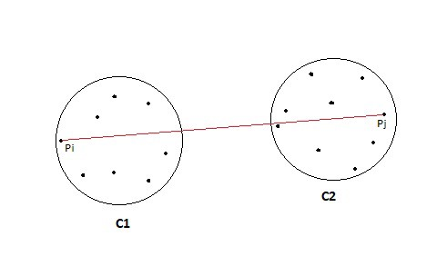
Calculating the similarity between two clusters
Calculating the similarity between two clusters is important to merge or divide the clusters. There are certain approaches which are used to calculate the similarity between two clusters:
MIN
MAX
Group Average
Distance Between Centroids
Ward’s Method
MAX: Also known as the complete linkage algorithm, this is exactly opposite to the MIN approach. The similarity of two clusters C1 and C2 is equal to the maximum of the similarity between points
MIN: Also known as single-linkage algorithm can be defined as the similarity of two clusters is equal to the minimum of the similarity between points

Slide 8
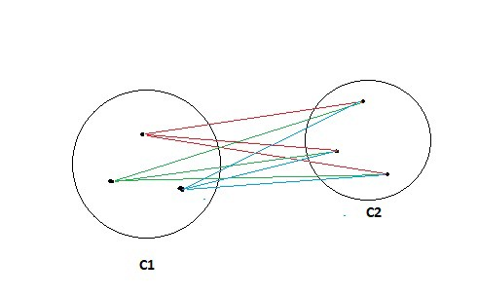
Calculating the similarity between two clusters
MIN: Also known as single-linkage algorithm can be defined as the similarity of two clusters is equal to the minimum of the similarity between points
MAX: Also known as the complete linkage algorithm, this is exactly opposite to the MIN approach. The similarity of two clusters C1 and C2 is equal to the maximum of the similarity between points
Group Average: Take all the pairs of points and compute their similarities and calculate the average of the similarities.

Slide 9
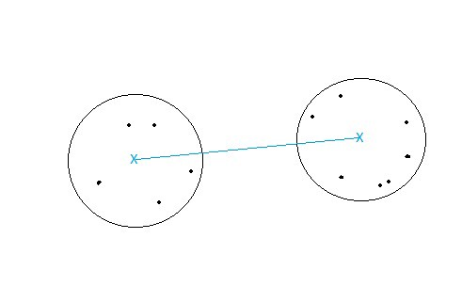
Calculating the similarity between two clusters
Distance between centroids:
Compute the centroids of two clusters C1 & C2 and take the similarity between the two centroids as the similarity between two clusters. This is a less popular technique in the real world.
Ward’s Method: This approach of calculating the similarity between two clusters is exactly the same as Group Average except that Ward’s method calculates the sum of the square of the distances Pi and PJ.
sim(C1,C2) = ∑ (dist(Pi, Pj))²/|C1|*|C2|
https://cs.wmich.edu/alfuqaha/summer14/cs6530/lectures/ClusteringAnalysis.pdf

